Slide 1

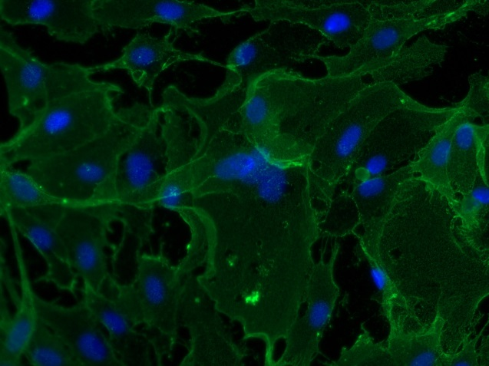
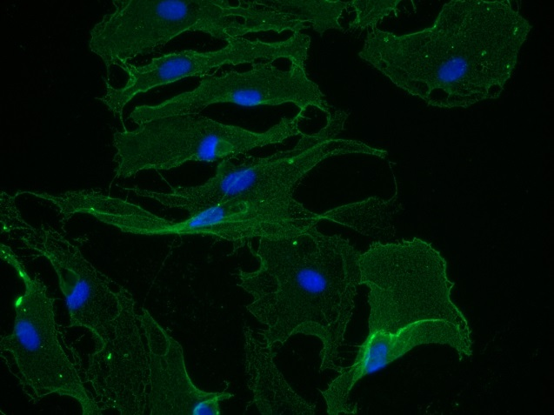
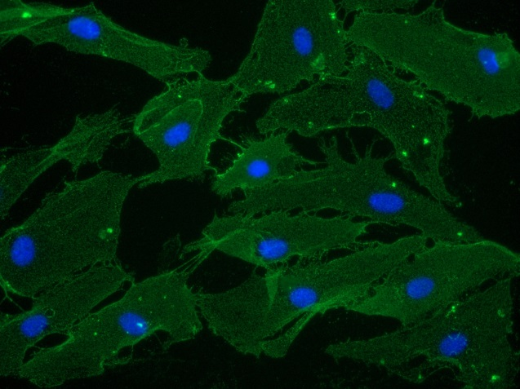

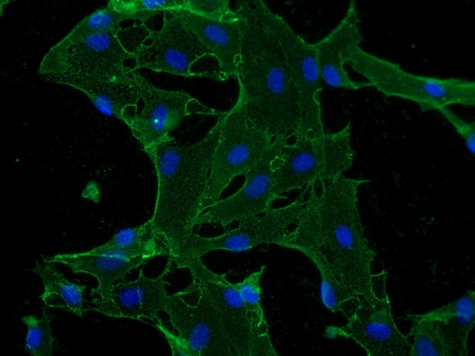
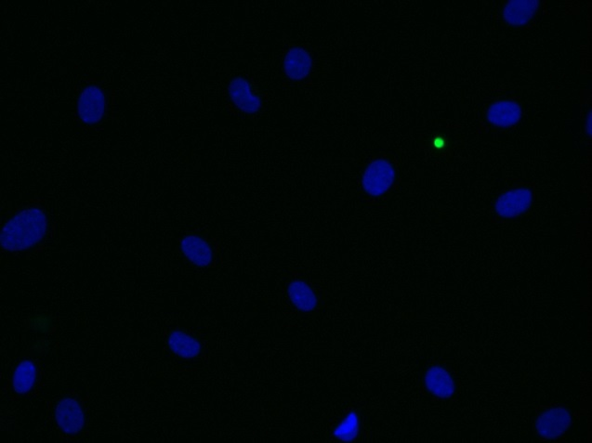
Reliatech GmbH
Mouse anti-human CD31 (#WM59)
(Cat #101-M92 / LEC1402-04)
1µg/ml
5µg/ml
10µg/ml
Fig. 1: Immunofluorescence staining of human CD31 (red) in HDLEC with a monoclonal mouse anti-human CD31 antibody [Cat# 101-M92]. Conjugated secondary antibody: goat anti-mouse ALEXA Flour 488 [Dianova].
[IF_LEC1402-04]
1µg/ml (#158-2B3)
Control: goat anti-mouse ALEXA Flour 488 (1:600)
http://www.reliatech.de / orders@reliatech.de

